Slide 1
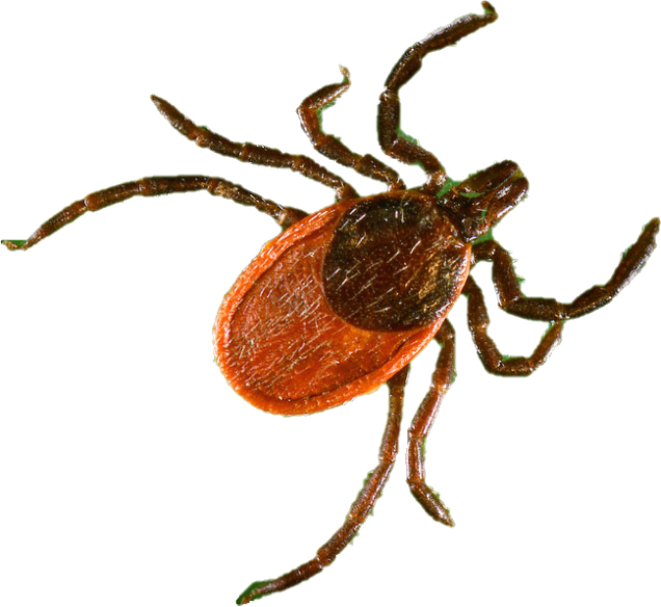
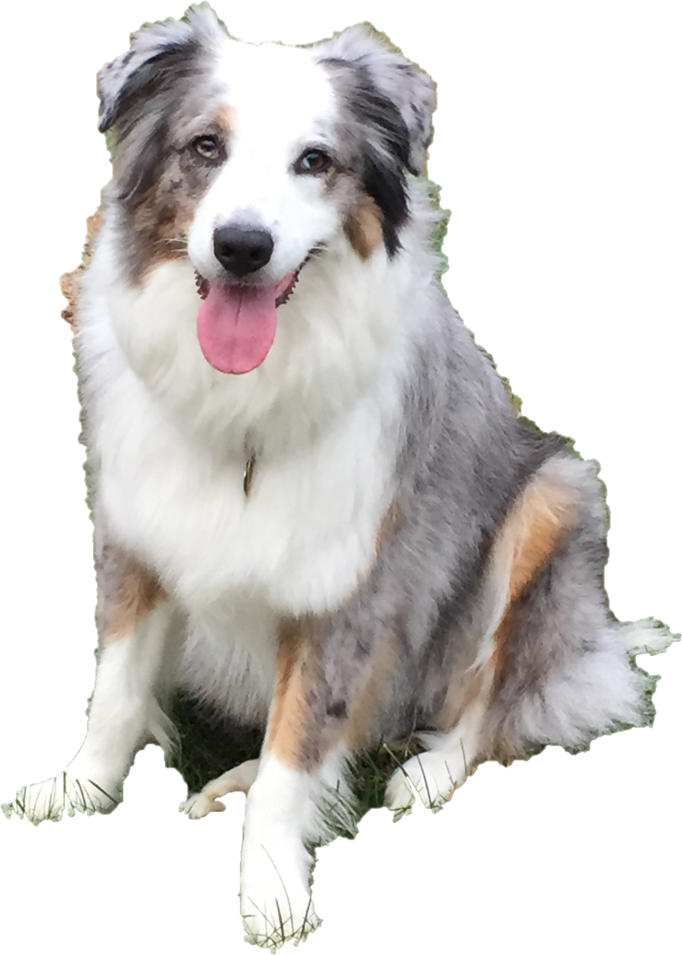
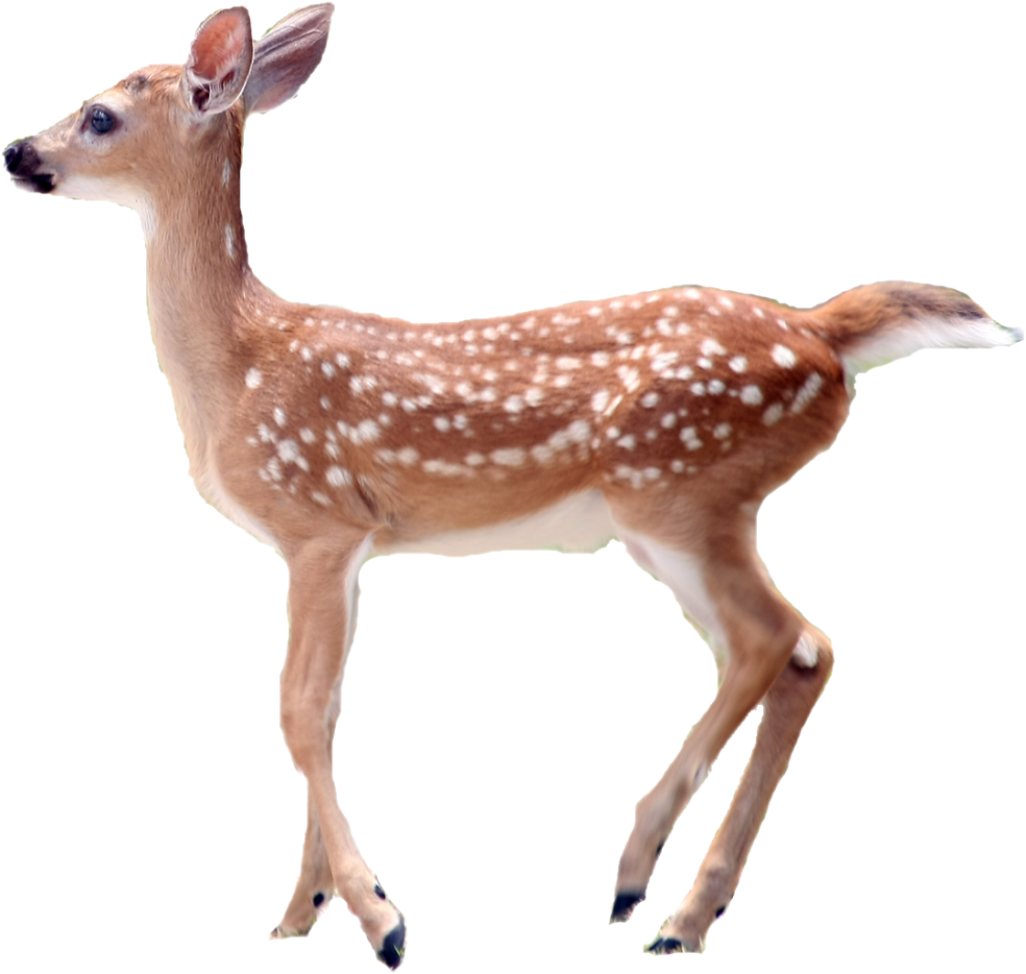
Ticks?!
July 2020
Notes:
Today we’re going to learn about a bug called a tick. Ticks can make us sick, so we have to be careful!
To start, let’s see if you can tell me what bug is in each picture.
Picture Sources:
https://www.needpix.com/photo/1357095/greengrass-grass-green-clipart-illustration-scrapbooking-white-background-art
https://www.goodfreephotos.com/vector-images/colorful-natural-tree-vector-clipart.png.php
https://newsd.co/man-tried-bid-goodbye-fawn-reacted-unbelievable-way-2/
CDC

Slide 2
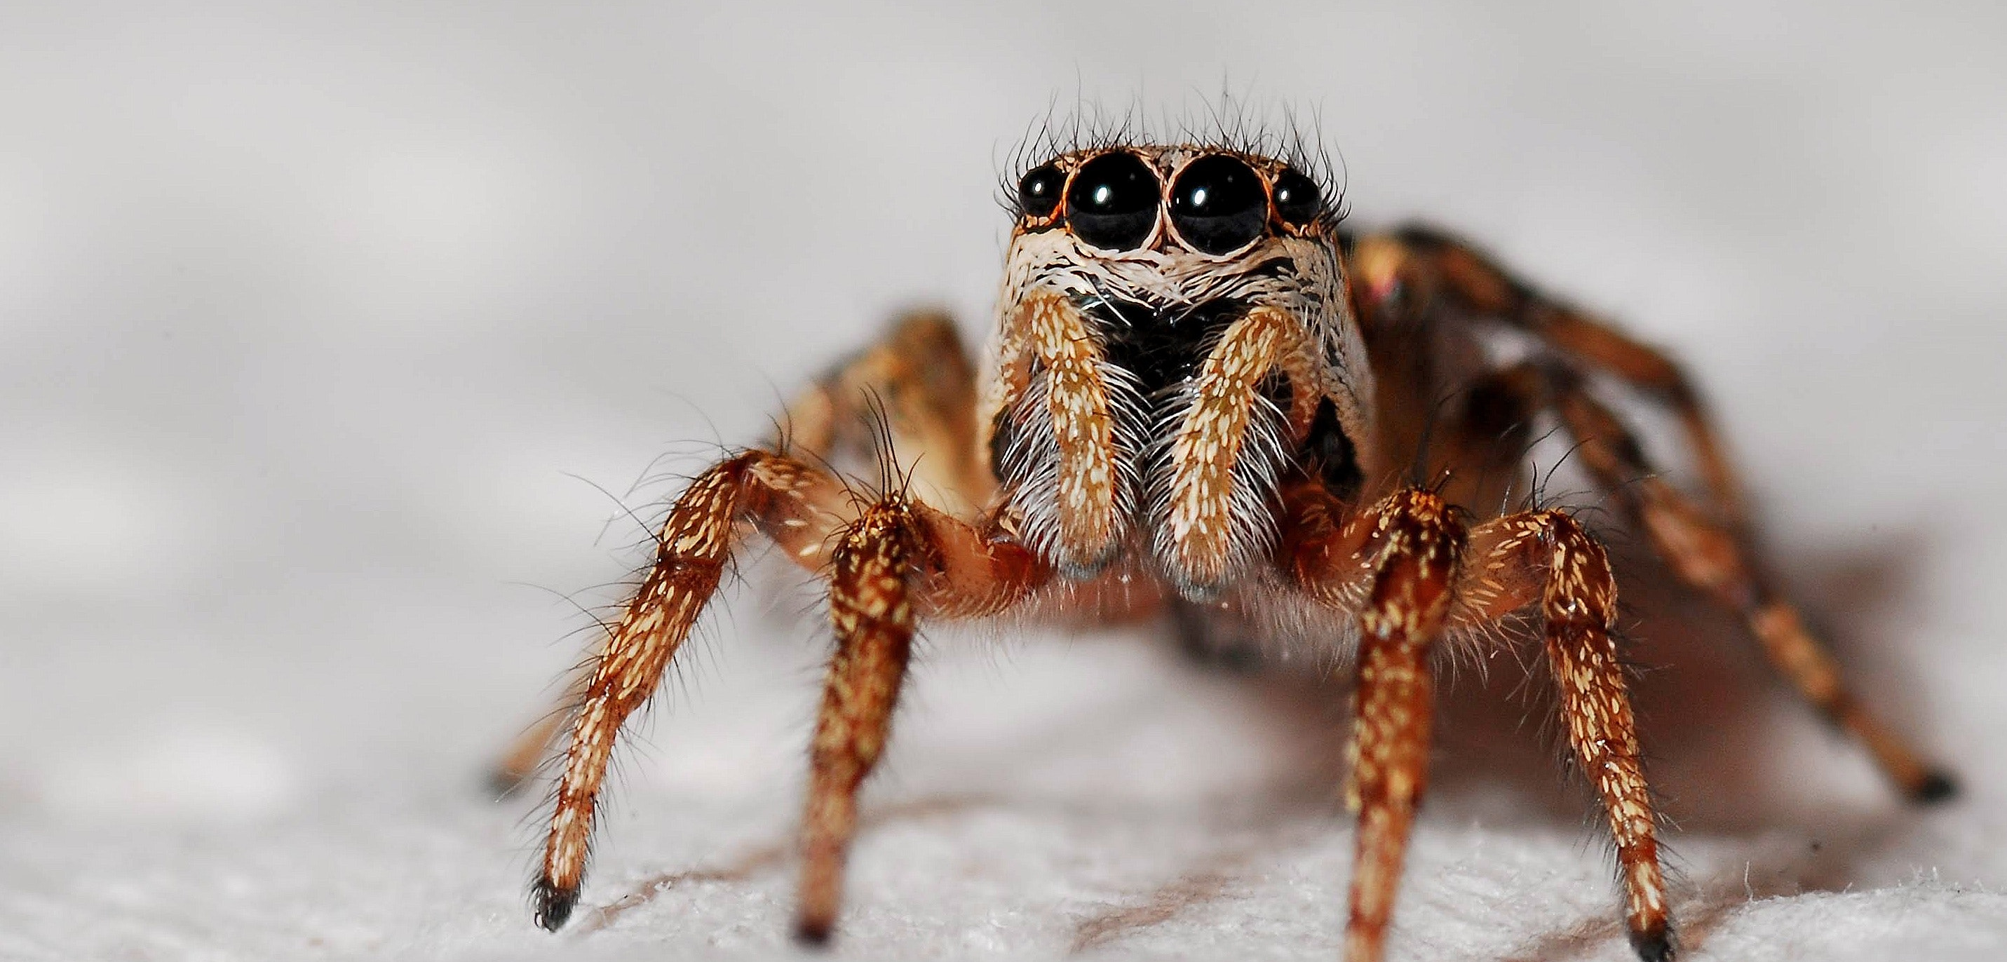
Notes:
Okay, first one, what is this bug called? Hint, it has 8 legs. It’s a spider!
Picture Source:
https://www.pexels.com/photo/nature-insect-macro-spider-40795/

Slide 3
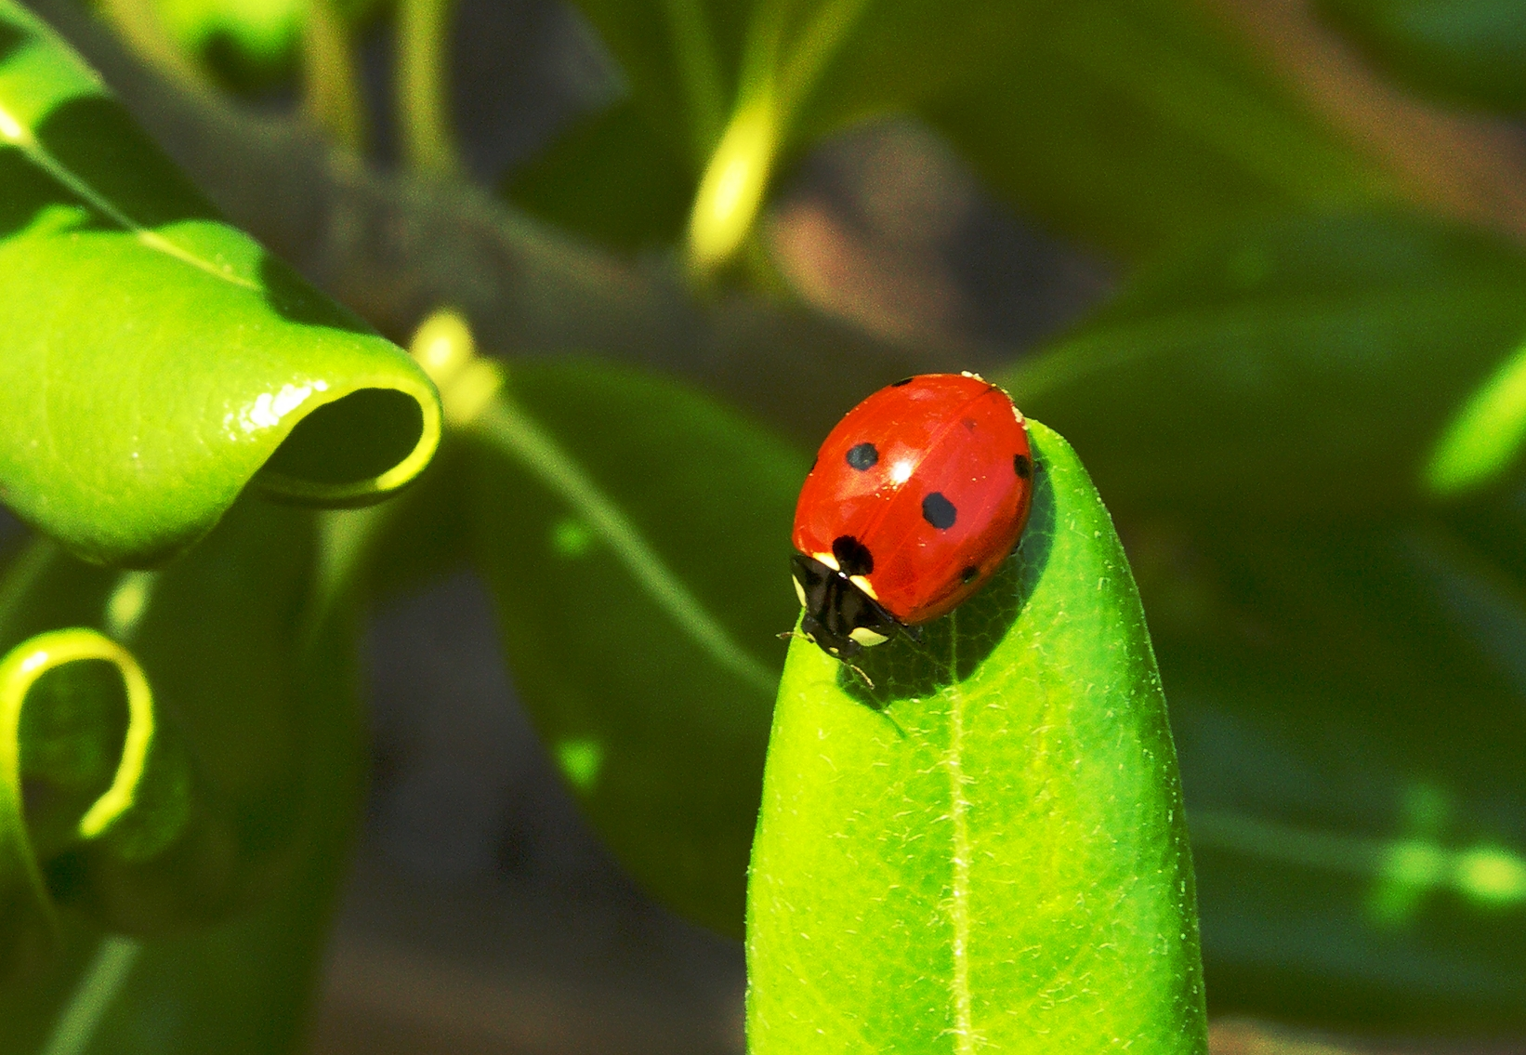
Notes:
What’s this? It’s a ladybug!
Picture Source:
https://commons.wikimedia.org/wiki/File:LadyBug-1.jpg

Slide 4
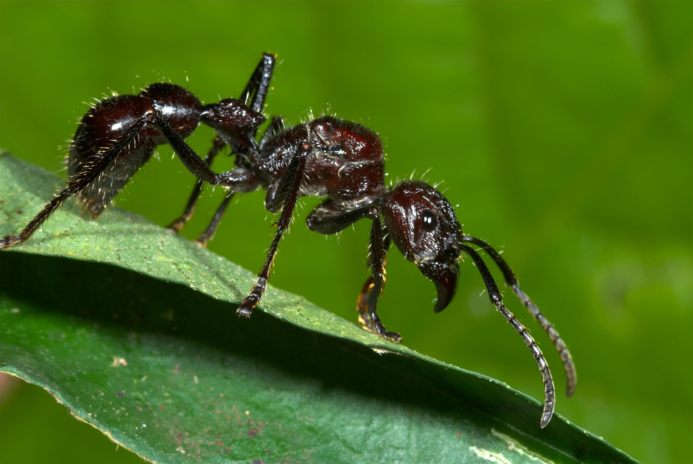
Notes:
And what about this one? You’re probably used to seeing them small and in the colors red and black. Hint, these bugs build little hills. It’s an ant!
Picture Source:
https://blog.nationalgeographic.org/2014/05/21/ask-your-weird-animal-questions-insect-edition-wings-stings/

Slide 5
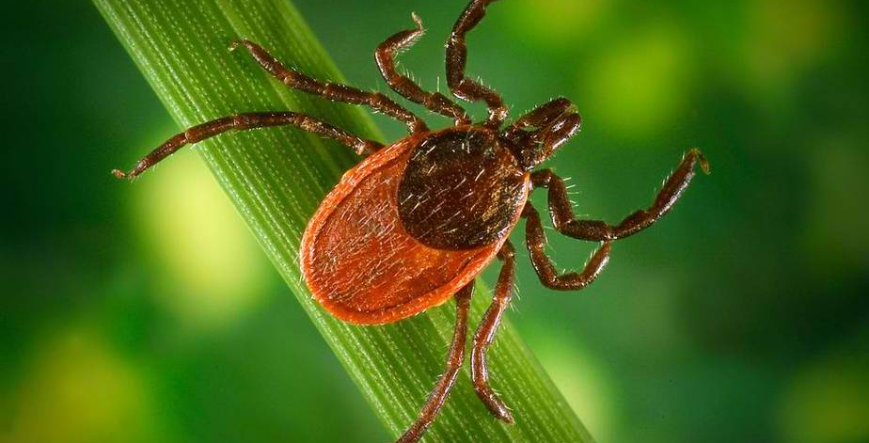
Notes:
Now does anyone know what this is? This is the tick! As you can see it has 8 legs just like the spider and is red and black like the ant. Ticks can be other colors and patterns too.
Sometimes, a tick can make you sick, so it’s important to know what ticks look like and what to do if you find a tick.
Picture Source:
https://insideclimatenews.org/species/insects/deer-tick

Slide 6
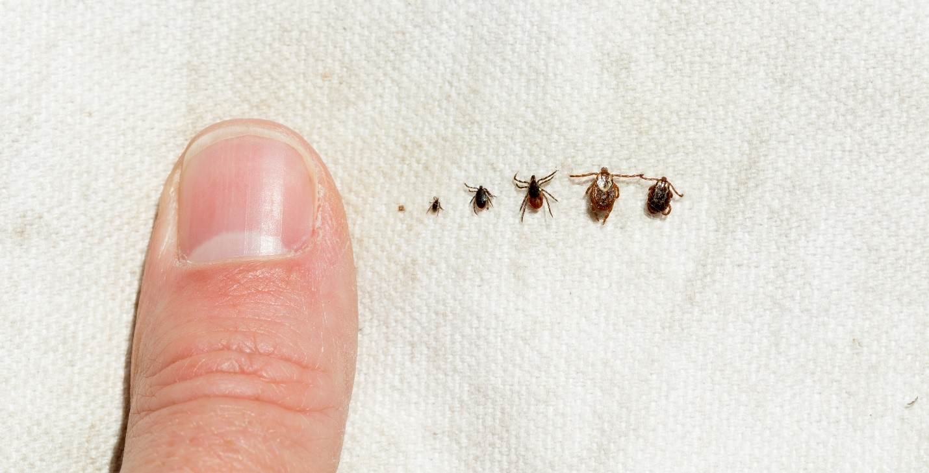
Notes:
You can see here the size of a tick against the size of a finger. All the way on the left is when the tick is a baby and you can see even when it’s fully grown it’s still really tiny! A full-grown tick is still only the size of a sesame seed or a freckle.
Picture Source:
https://www.health.state.mn.us/diseases/tickborne/ticks.html

Slide 7
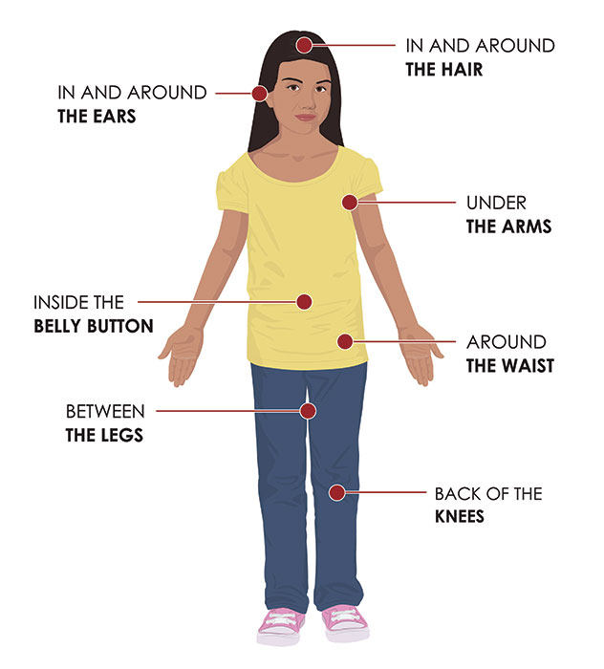
Notes:
Because ticks are so small, your parents can help you perform something called a tick check when you come inside from playing outside. Ticks live in the grass especially in the woods so when you play in those areas they can crawl on you and bite you. Your parent can help you look in all of these places like behind your ears, under your armpits, and even in your belly button! It’s like a big game of hide and seek.
Photo from cdc.gov

Slide 8
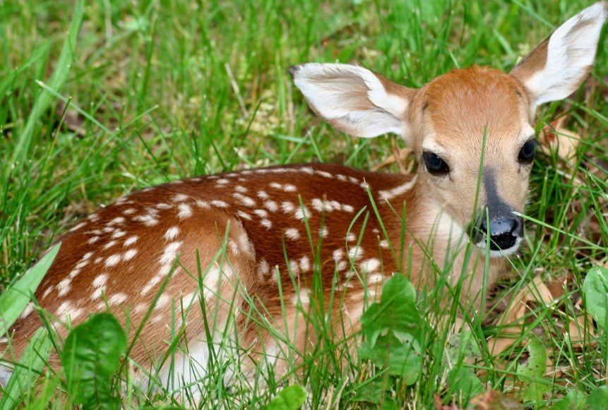
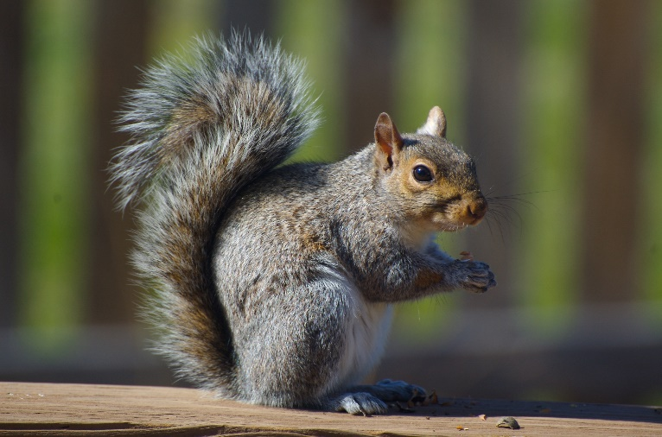
Ticks also like to ride on animals such as…
Notes:
Ticks are really tiny and can’t move very far or fast, so they like to catch rides on other animals that walk by them. Some of these animals include squirrels and deer. Can you think of any other animals that might carry ticks? (examples include any small mammals such as a fox, a mouse, a groundhog, etc). How many of you have pets?
Picture Sources:
This Photo by Unknown Author is licensed under CC BY-SA
This Photo by Unknown Author is licensed under CC BY-SA

Slide 9
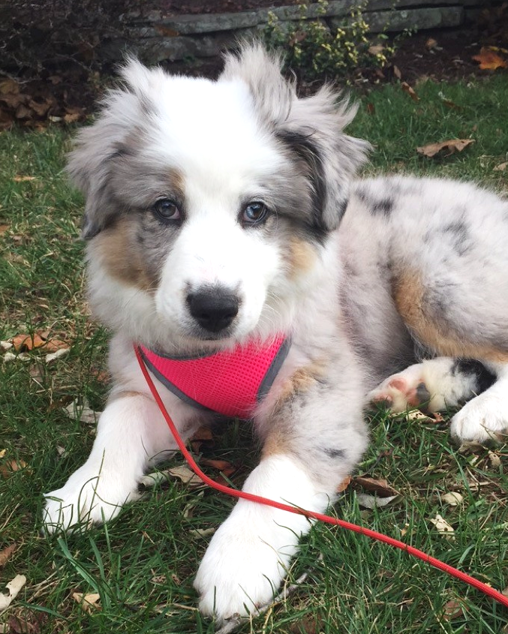
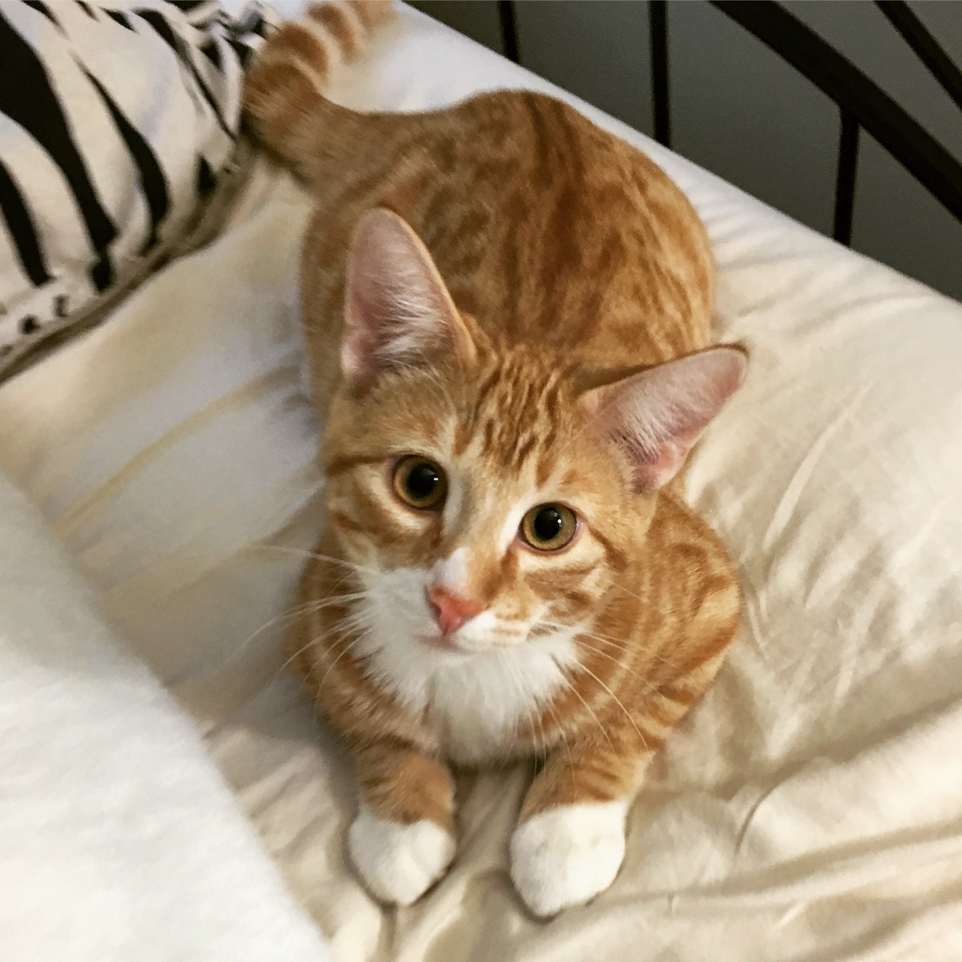
Notes:
Just like other animals, your pets can carry ticks and bring them into your home. For this reason, you should tell your parents that when you get a tick check, your pet needs to get checked too! When checking your pet, pay close attention to their head and behind their ears because that’s where ticks really like to hide.
Picture Source:
https://upload.wikimedia.org/wikipedia/commons/6/66/An_up-close_picture_of_a_curious_male_domestic_shorthair_tabby_cat.jpg

Slide 10
Don’t let a
TICK
SICK!
Make you
Notes:
We’re going to send you home with a letter for your parents and a coloring page for you to do. We’re also going to give you a tick check calendar so every time you and your parents do a tick check you can put a sticker on that day! Don’t let a tick make you sick!

